Slide 1
FROM THE CITY TO THE COUNTRYSIDE
OUR JOURNEY CONTINUES…

Slide 2
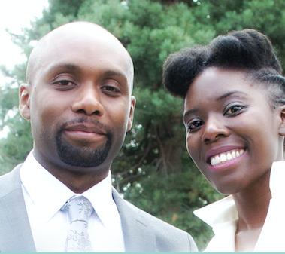
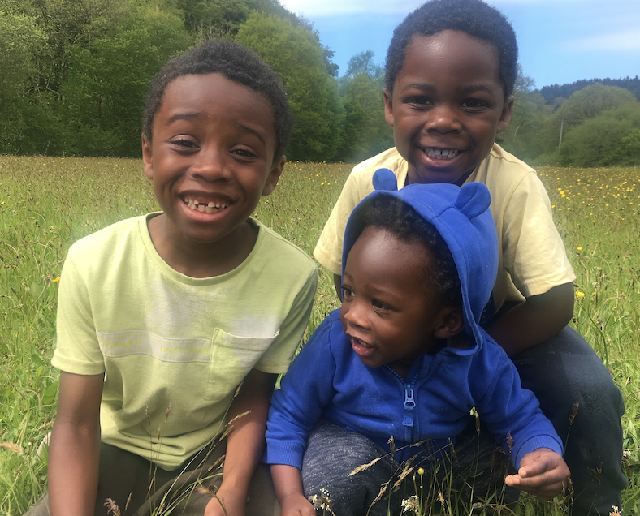
HELLO! wE’RE THE SCOTTs

Slide 3
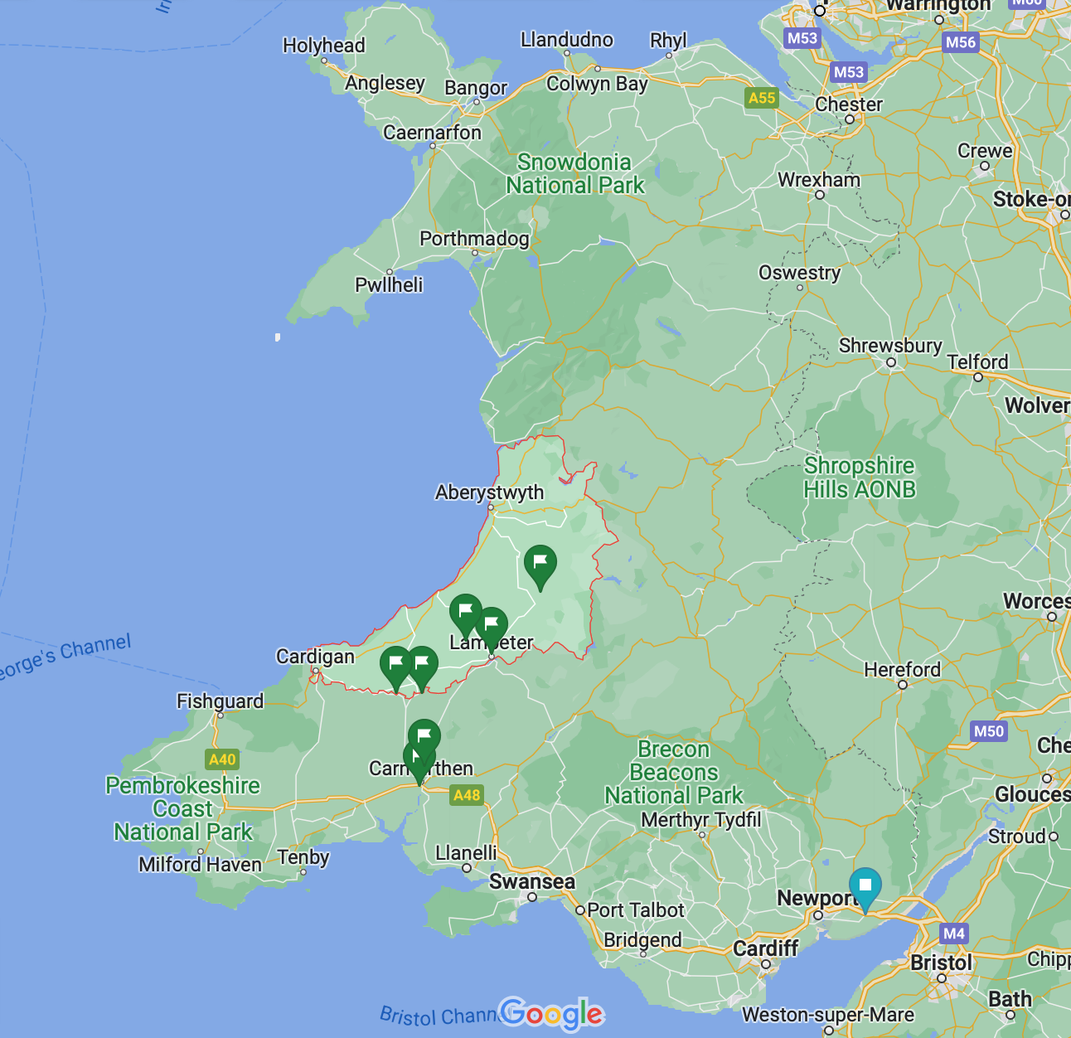
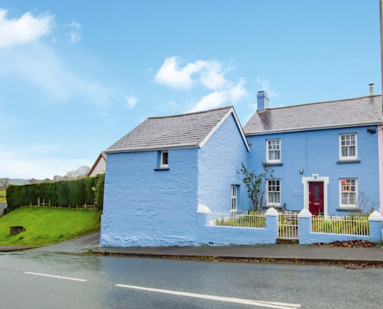
WE LIVE IN A RURAL VILLAGE IN WEST WALES…
OUR CURRENT HOMe

Slide 4
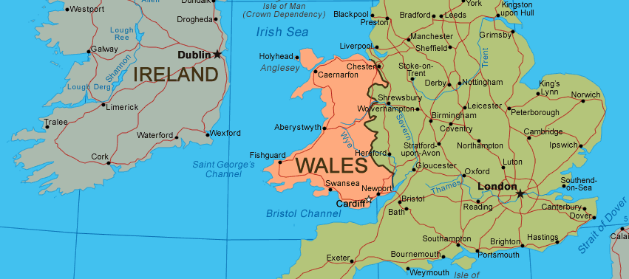
2020 - MOVED FROM LONDON TO WALES DURING THE PANDEMIC!

Slide 5
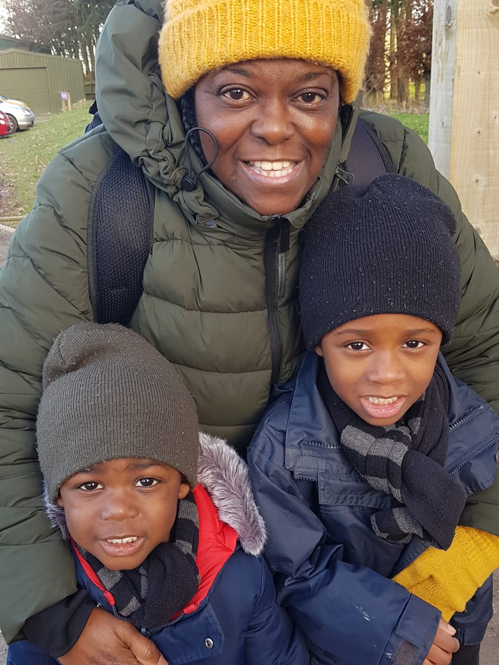
HOW OUR JOURNEY STARTED…
IDEAL LOCATION: BRISTOL, UK
2019
WE NEEDED SOMEWHERE TO LIVE
(FIRST TIME BUYERS)
TO BE CLOSER TO MY MUM
BUT GOD HAD OTHER PLANS…

Slide 6
REWIND BACK TO 2010 - STEPPING STONES TO HOW WE GOT HERE…
COUNTRY LIVING
MEDICAL MISSIONARY WORK
2010
8 LAWS OF HEALTH
2013
2014
2015
HOME EDUCATION
BABY NO.1
MARRIED
OFFICIALLY OUT OF A JOB AND BECAME A FULL TIME MUM
VISITED SMALL CHURCH AND REMAINED FOR JUST UNDER 5 YEARS
UNMARRIED AND HAD NO PLANS TO LEAVE LONDON - WE WERE TOO COMFORTABLE!
ONE OF GOD’S PLANS FOR HIS REDIRECTION OF OUR LIVES…

Slide 7
Fast forward to 2018
VIEWED THIS HOUSE BUT DIDN’T PLACE AN OFFER
GOD WAS WORKING THROUGH MY HUSBAND
NEED SOMEWHERE TO LIVE
COULDN’T FIND ANY PROPERTIES WE WANTED IN BRISTOL, THROUGHOUT OUR SEARCH IN THE SUMMER
2 CHILDREN
3RD CHILD DUE
DARREN CURRENTLY WORKING AS ELECTRICIAN FOR A LARGE COMPANY
DARREN SUGGESTED WE START LOOKING IN WALES AND IMPRESSED TO LOOK INTO COUNTRY LIVING. HE ALSO HAS BEEN OFFERED CONFIRMATION OF A DIRECT TRANSFER FOR HIS JOB TO WALES
2018
I WAS WORKING AS A VIRTUAL OFFICE MANAGER FOR A VEGAN RESTAURANT IN LONDON FROM SPRING 2017
2019
2020
MY JOB AS VIRTUAL MANAGER CAME TO AN END IN THE AUTUMN
GOD’S PLAN (SOMETHINGS ARE ONLY FOR A SEASON)
GOD WAS PROVIDING FINANCES QUICKLY! WE WERE ABLE TO LIVE WITH MY MOTHER IN-LAW WHICH HELPED SPEED THIS UP

Slide 8
WE PUT OFFERS ON OTHER PROPERTIES BUT THEN QUICKLY RETRACTED DUE TO MANY ISSUES…
WE PUT AN OFFER ON THIS HOME, WHICH WAS ACCEPTED
AND THEN COVID HAPPENED…

Slide 9
YEAR 2020
THE BIG MOVE
DARREN’S TRANSFER IN PLACE AND RETURNS TO WALES TO JOIN US
MY MUM PASSED AWAY
FIRST WEEK IN FEBRUARY:
OFFER ON HOUSE ACCEPTED
TRAVEL TO BRISTOL WITH THE CHILDREN TO BE WITH MY MUM FOR 2 WEEKS
DARREN BACK TO LONDON FOR WORK
FEB
LOCKDOWN IN THE UK
JULY
AUG
OCT
START PRAYING FOR GOD TO OPEN THE DOOR AND START PACKING
THE LORD KNEW I NEEDED TO PACK BECAUSE I WOULD BE IN BRISTOL AND UNABLE TO HELP MY HUSBAND WITH THE MOVE BACK IN LONDON
GOD OPENS THE DOOR FOR US TO LEAVE

Slide 10
THINGS TO LEARN FROM…
IT’S ALWAYS MUCH HARDER OR EVEN IMPOSSIBLE TO MOVE DURING A CRISIS - DON’T GET CAUGHT OUT!
GO WHERE GOD LEADS YOU, AND DON’T BE STUBBORN AS THIS CAN CAUSE DELAYS OR CLOSE THE DOOR COMPLETELY
REMEMBER, THE “STEPPING STONES” YOU MAY BE ON AT THE MOMENT ARE HEADED TOWARDS THE PLACE WHERE GOD INTENDS TO TAKE YOU - TRUST HIS TIMINGS!
HAVING A TRADE AND BEING SELF EMPLOYED CAN BE VERY BENEFICIAL WHEN IN THE COUNTRYSIDE FOR WORK - BEING HANDY AND KNOWING HOW TO DO OR FIX THINGS YOURSELF IS A PLUS!
BE OPEN MINDED - OPEN TO CHANGE, WILLING TO ADAPT (EVEN WHEN IT COMES TO YOUR PROFESSION)
HARD TIMES AND DIFFICULTIES MAY BE PLACED IN YOUR WAY TO THROW YOU OFF TRACK, BUT DON’T GIVE UP AND DON’T LOOSE HOPE!

Slide 11
OUR THOUGHTS AT THE BEGINNING OF OUR JOURNEY…
WE DIDN’T WANT TO MAKE ANY RUSHED DECISIONS SEEKING LAND
WE DIDN’T WANT A BIG PROJECT ON OUR HANDS
WE DIDN’T WANT TO BE FAR FROM FAMILY AND A CHURCH COMMUNITY
OUR THOUGHTS NOW…
THIS ISN’T OUR ‘FOREVER HOME’
INCLINED TOWARDS LOOKING AT BUILDING OUR NEXT HOME
TO BE COMPLETELY SELF SUFFICIENT
PLANNING PERMISSION NEEDED FOR CHANGE OF USE ON SOME LAND - TIME FOR RESEARCHING IS NEEDED!
OUR JOURNEY STILL CONTINUES…

Slide 12
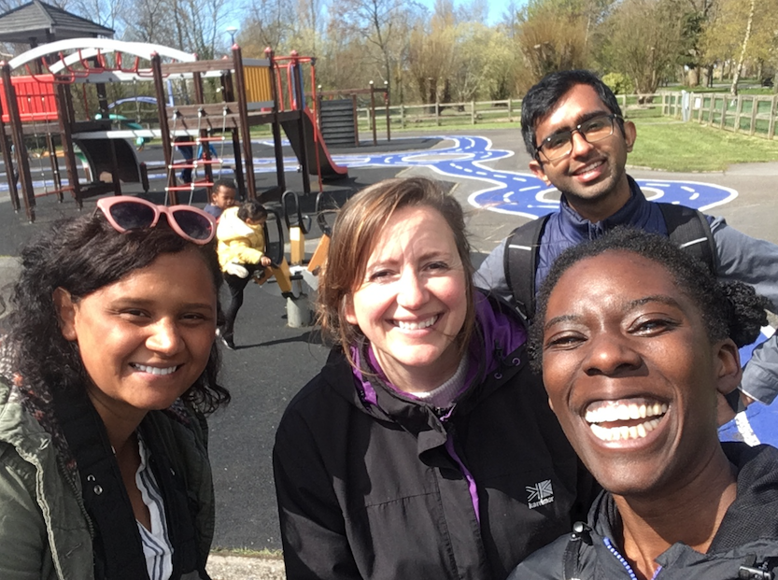
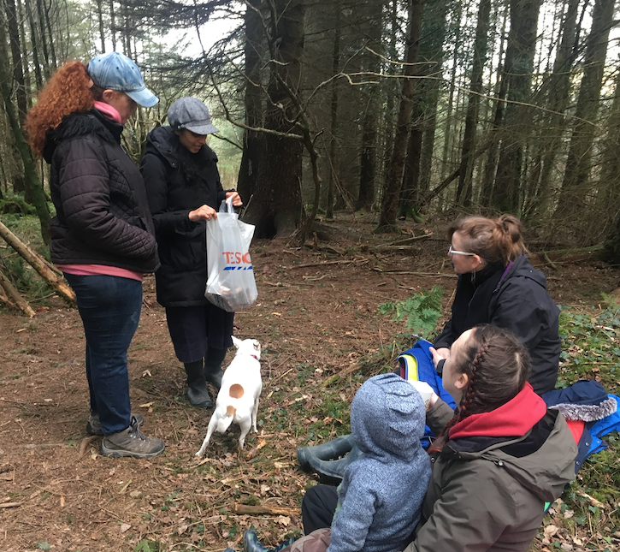
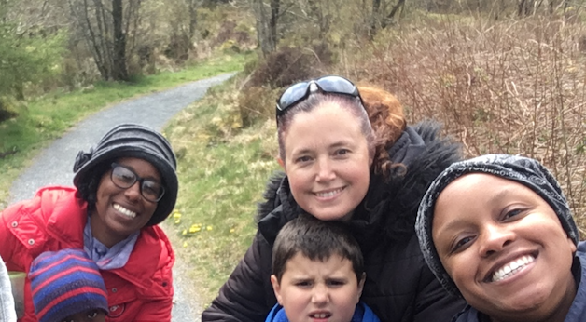
THINGS WE WERE’NT EXPECTING TO HAVE HERE…
GOD HAS BLESSED US WITH A LOCAL CHURCH AND HOME SCHOOL COMMUNITY
WE STARTED A WEEKLY HOME EDUCATION MEET UP FOR OUR CHILDREN
GOD IS USING US HERE TO WITNESS TO OTHERS
THERE’S WORK TO BE DONE HERE TOO, IN BRINGING OTHERS TO CHRIST!

